Slide 1
COGS 108 Final Project

Slide 2

HELLO!
My name is Dominick Lee
Math CS Major at UCSD

Slide 3
Background and Hypothesis
1
Laplace’s Rule of Succession

Slide 4
Hypothesis
Restaurants with a better overall rating maintain a higher standard of sanitation and will thus have fewer violations
A restaurant with better reviews likely had better food prepared in a more sanitary environment and is thus more likely to receive fewer violations

Slide 5
All the effects of Nature are only the mathematical consequences of a small number of immutable laws. - Laplace

Slide 6
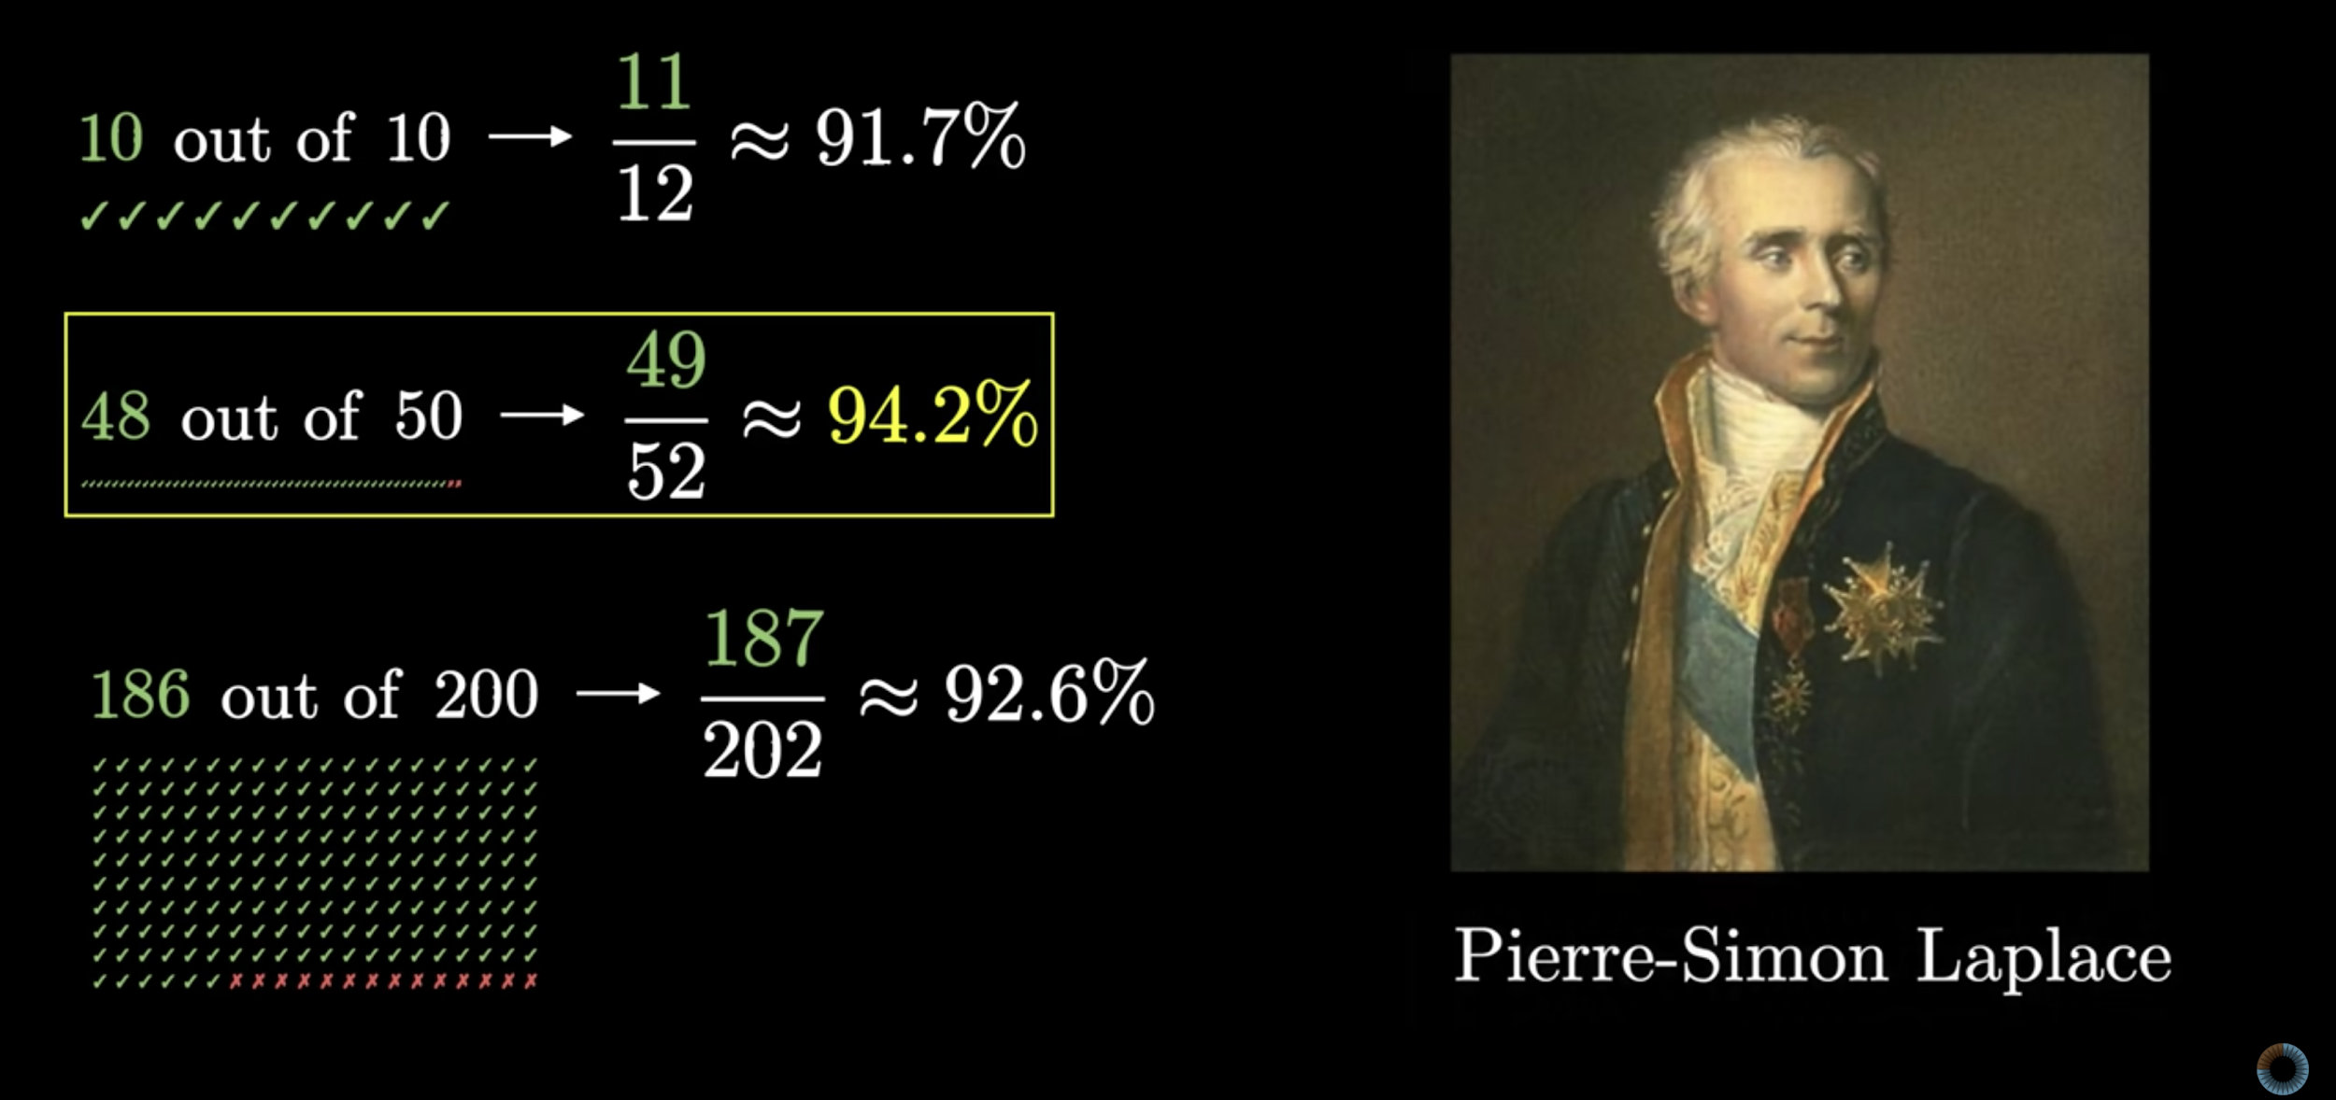

Laplace’s Rule Of Succession
3Blue1Brown’s youtube video
Binomial distributions | Probabilities of probabilities, part 1
https://www.youtube.com/watch?v=8idr1WZ1A7Q

Slide 7
Data and Results
Did standardization make a difference?

Slide 8
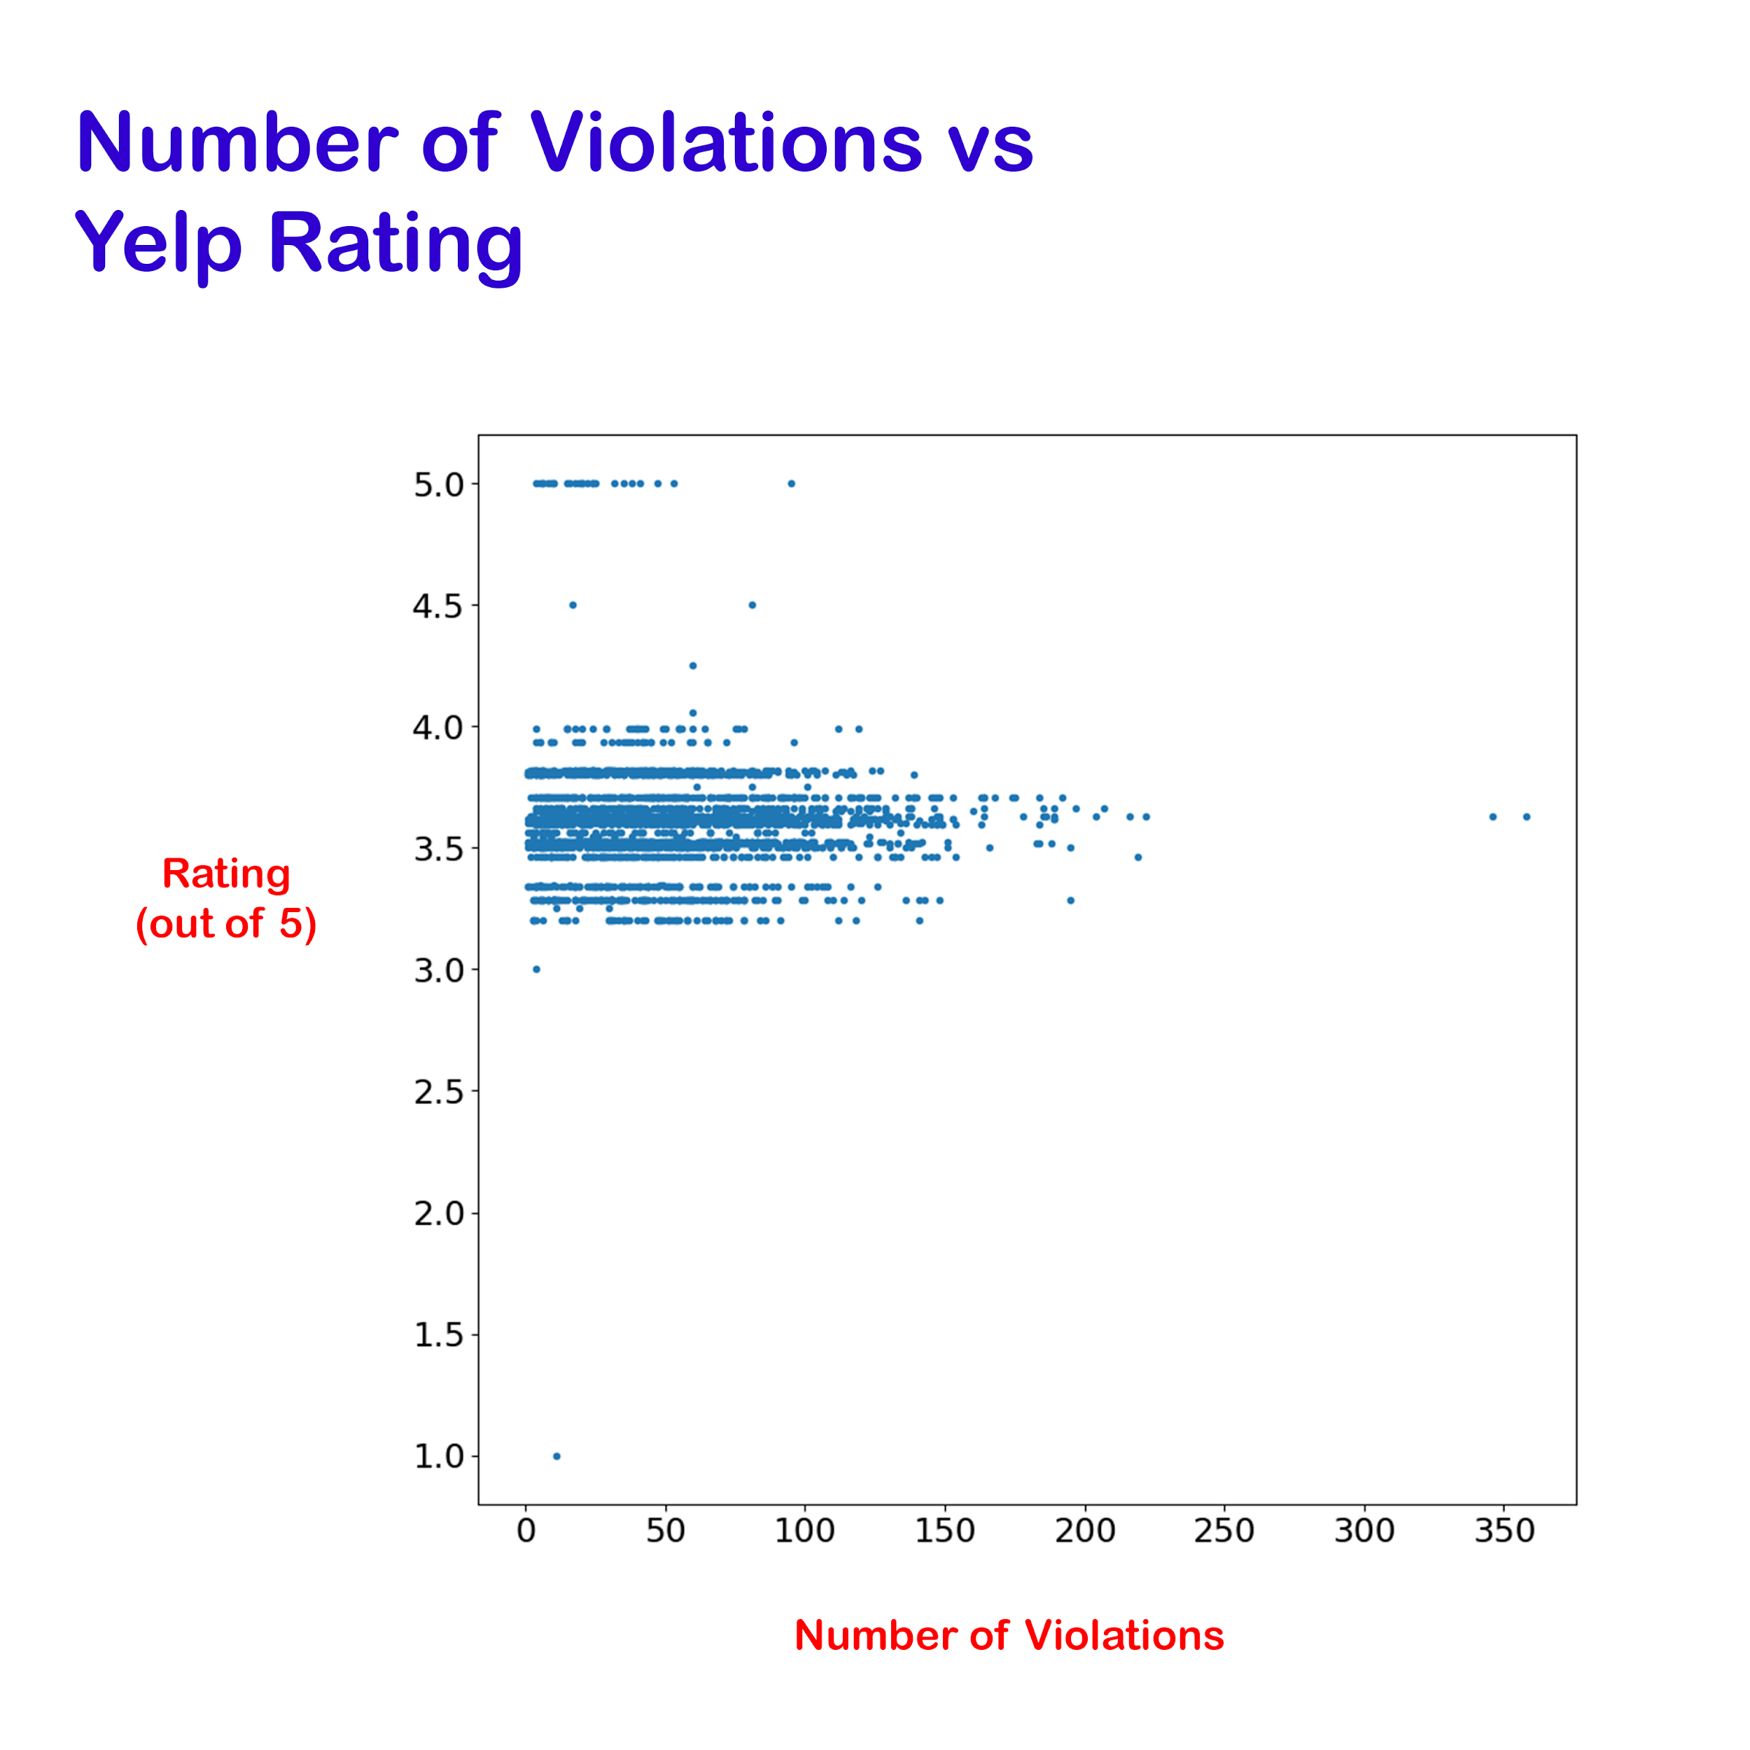
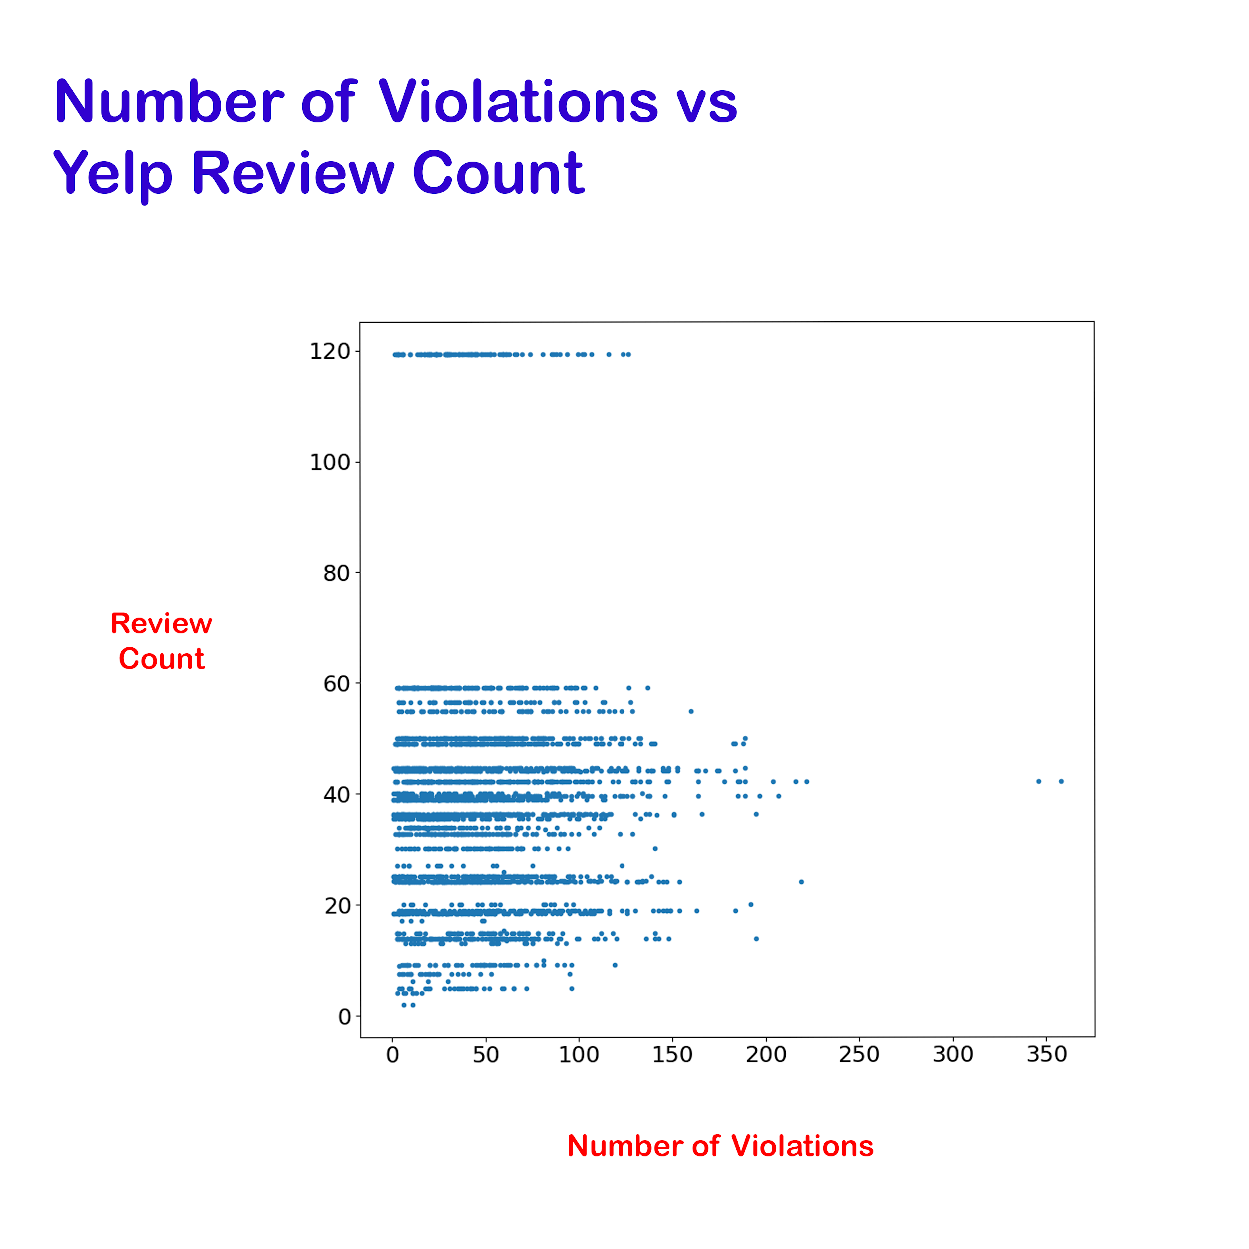
Using Yelp Rating and Review Count

Slide 9
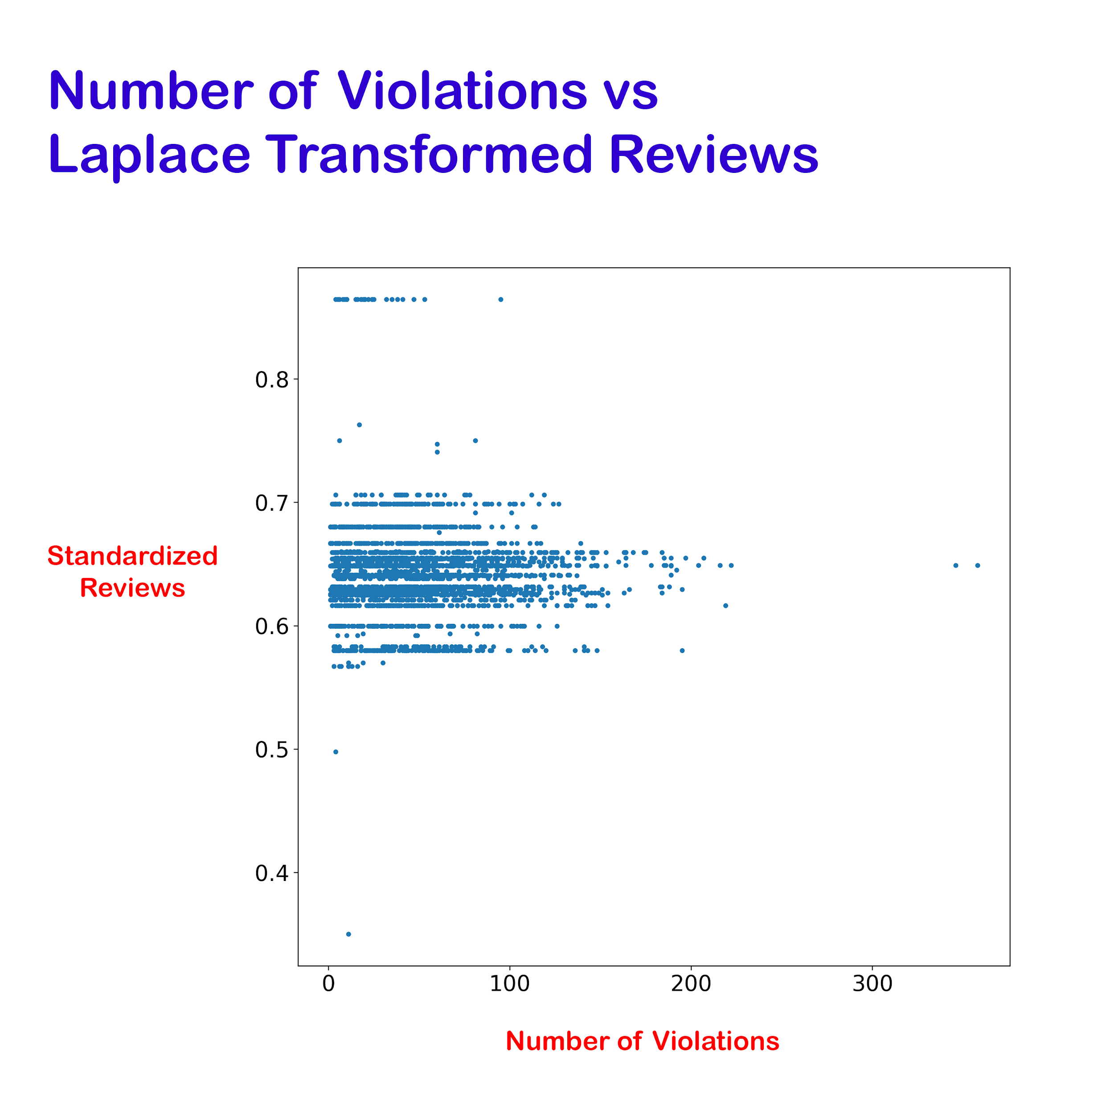
Laplace Transformed Results

Slide 10

What this means?
No Correlation?

Slide 11
R = -0.0305
No Correlation was found

Slide 12
R = 0.0028
R = -0.0315
R = -0.0305
Using Review Count
Using Rating
Using Laplace Rule of Succession

Slide 13
THANKS!
Any questions?
Find me on GitHub @Domogami
PID : A15588401

Slide 14
CREDITS
Special thanks to all the people who made and released these awesome resources:
Presentation template by SlidesCarnival
Photographs by Startup Stock Photos

